Slide 1
COMP-4270 Operating Systems Prog2: Code Review
Dr. Myounggyu Won
Reference: Operating Systems Concepts – 9th Edition

Slide 2
Data Structures

Slide 3
Data Structures (1/3)
Constant variables
/* End game after this many moves: */
#define MAX_MOVES 500000
/* Show field roughly once per epoch: */
#define MOVES_PER_EPOCH (MAX_MOVES / 10)
/* Field size: */
#define HSIZE 76
#define VSIZE 20
#define NUM_PLAYERS 4
#define NUM_BALLS 2
static const int RED_TEAM = 0;
static const int BLUE_TEAM = 1;

Slide 4
Data Structures (2/3)
Static global variables
Visible within this c file.
Shared among threads.
/* Counters: */
static int moves = 0;
static int epochs = 0;
/* Random-number state: */
static rand_state_t r;
/* Game stats (per team): */
static int passes[2] = { 0, 0 };
static int steals[2] = { 0, 0 };
RED_TEAM
BLUE_TEAM

Slide 5
Data Structures (3/3)
static struct player_t *field[VSIZE][HSIZE];
typedef struct player_t {
int rank;
int team;
int field_x, field_y;
struct ball_t *ball;
pthread_t task;
} player_t;
VSIZE
typedef struct ball_t {
int field_x, field_y;
player_t *carried_by; /* NULL => directly on field */
} ball_t;
HSIZE
static player_t red[NUM_PLAYERS];
static player_t blue[NUM_PLAYERS];
static ball_t ball[NUM_BALLS];

Slide 6
Random Number Generator

Slide 7
No need to make any change to the random number generator.
/**********************************************************************/
/* Random-number generator */
/* This is a stripped-down version of random.c as distributed with
FreeBSD 2.2 */
#defineDEG31
#defineSEP3
typedef struct rand_state_t {
short fpos, rpos;
int state[DEG];
} rand_state_t;
static int bsd_rand(int n, rand_state_t *r)
{
int i;
r->state[r->fpos] += r->state[r->rpos];
i = (r->state[r->fpos] >> 1) & 0x7fffffff; /* chucking least random bit */
if (++(r->fpos) >= DEG) {
r->fpos = 0;
r->rpos++;
} else if (++(r->rpos) >= DEG)
r->rpos = 0;
return i % n;
}
static void bsd_srand(int x, rand_state_t *r)
{
register int i;
r->state[0] = x & 0x7fffffff;
for (i = 1; i < DEG; i++) {
register long hi, lo, v;
v = r->state[i - 1];
hi = v / 127773;
lo = v % 127773;
v = 16807 * lo - 2836 * hi;
if (v <= 0)
v += 0x7fffffff;
r->state[i] = v;
}
r->fpos = SEP;
r->rpos = 0;
for (i = 0; i < 10 * DEG; i++) {
(void)bsd_rand(1, r);
}
}

Slide 8
Main

Slide 9
/* Give one ball to each team: */
ball[0].carried_by = &red[0];
ball[1].carried_by = &blue[0];
for (i = 0; i < NUM_BALLS; i++) {
ball[i].carried_by->ball = &ball[i];
ball[i].field_x = ball[i].carried_by->field_x;
ball[i].field_y = ball[i].carried_by->field_y;
}
int main()
{
/* Initialize and put players on the field: */
for (i = 0; i < NUM_PLAYERS; i++) {
red[i].rank = 2*i;
red[i].field_x = i;
red[i].field_y = 0;
red[i].team = RED_TEAM;
red[i].ball = NULL;
field[0][i] = &red[i];
blue[i].rank = 2*i + 1;
blue[i].field_x = i;
blue[i].field_y = VSIZE-1;
blue[i].team = BLUE_TEAM;
blue[i].ball = NULL;
field[VSIZE-1][i] = &blue[i];
}
Arrow operator (->): gets the member
from a structure pointed by a pointer.

Slide 10
/* Start the players: */
for (i = 0; i < NUM_PLAYERS; i++) {
pthread_create(&red[i].task, NULL, run_player, &red[i]);
pthread_create(&blue[i].task, NULL, run_player, &blue[i]);
}
/* Update field display occassionally: */
while (moves < MAX_MOVES) {
if (epochs > prev_shown_epochs) {
show_field();
prev_shown_epochs = epochs;
}
}
/* Game over. Wait for players to stop, then show field
one last time (just in case). */
printf("Game over\n");
for (i = 0; i < NUM_PLAYERS; i++) {
pthread_join(red[i].task, NULL);
pthread_join(blue[i].task, NULL);
}

Slide 11
Start Routine

Slide 12
void *run_player(void *_p)
{
// p: this player, p2: other player in the vicinity
player_t *p = (player_t *)_p, *p2;
while (1) {
// move this player
// code omitted …
if ((x >= 0) && (x < HSIZE)
&& (y >= 0) && (y < VSIZE)) {
p2 = field[y][x]; // find p2 at location (y,x).
if (!p2) { // p2 = null -> no player around at (y,x).
/* move */
} else {
if (p->ball && (p->team == p2->team) && !p2->ball) {
/* try to pass */
} else if (!p->ball && (p->team != p2->team) && p2->ball) {
/* try to steal... */
} else {
/* do nothing */
}
}
}
}
}

Slide 13
/* try to pass */
if (contest(p, p2)) {
/* a pass */
p2->ball = p->ball;
p->ball->field_x = x;
p->ball->field_y = y;
p->ball->carried_by = p2;
p->ball = NULL;
passes[p->team]++;
}
/* try to steal... */
if (contest(p, p2)) {
/* a steal */
p->ball = p2->ball;
p2->ball = NULL;
p->ball->field_x = p->field_x;
p->ball->field_y = p->field_y;
p->ball->carried_by = p;
steals[p->team]++;

Slide 14
Mutex Lock

Slide 15
What are the variables that are changed by multiple threads?
Do we have a critical section (i.e., code segment that changes the shared variables) in the show_field() function?
How about the contest() and run_player(), and even main()?
Guard the critical sections using one or more mutex locks.
How to do it:
pthread_mutex_t lock;
Random Generator()
Run_player()
{
…
pthread_mutex_lock(&lock);
critical section
pthread_mutex_unlock(&lock);
…
}
…
Show_field() { … }
Contest() { … }
Main()
{
if (pthread_mutex_init(&lock, NULL) != 0)
{
printf("\n mutex init failed\n");
return 1;
}
…
…
pthread_mutex_lock(&lock);
critical section
pthread_mutex_unlock(&lock);
…
…
pthread_mutex_destroy(&lock);
}

Slide 16
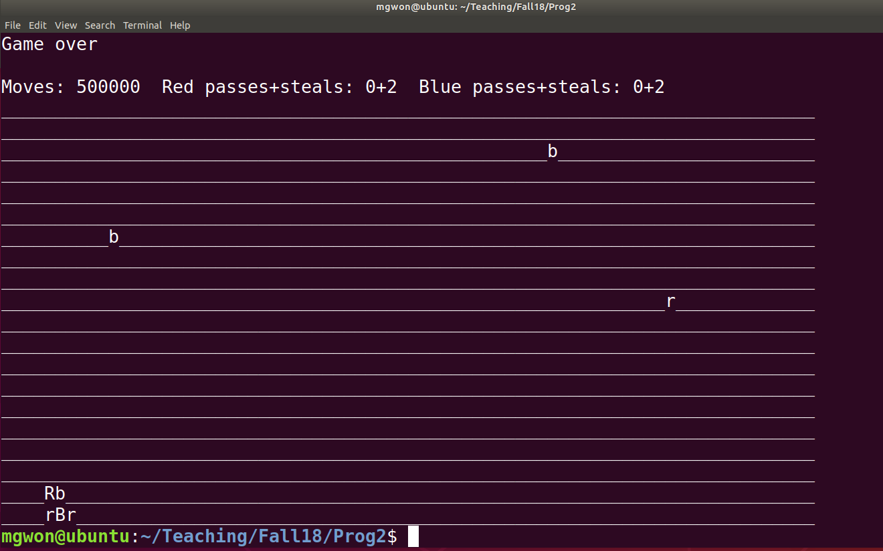
Correct Output
If everything is good, your program should output with “game over” and Moves of 500000.

